Slide 1


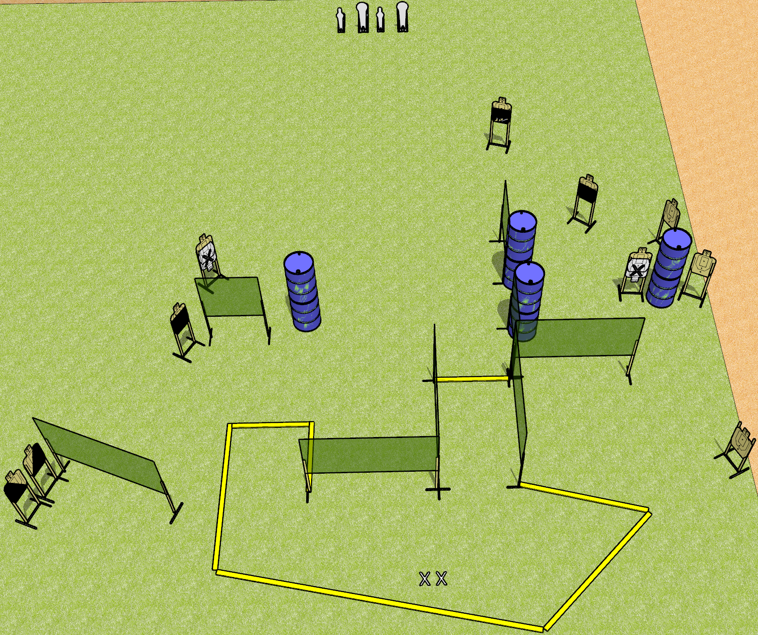
 | Dothan Gun Club – USPSA Match Well Technically Course Designer : Drew Coleman
Round Count 24 rounds 10 USPSA targets 2 colt poppers, 2 mini poppers
Equipment List 13 wall feet 1 action target, 2 50%, 1 left and 1 right diagonal

Slide 2
Well Technically
Written Stage Briefing
Well Technically is a 24 round, 120 point, Comstock field course. There are 10 USPSA targets, 2 colt poppers, and 2 mini poppers. The best 2 hits on paper will score, and steel must fall to score. The start signal is audible.
Handgun start position is both feet on X’s, wrists above shoulders. Handgun is loaded and holstered.
PCC start position is both feet on X’s. Loaded carbine is held with both hands, stock on belt, safety on.
On start signal, engage targets as they become available from within the shooting area.

